Slide 1
Publisher: S5 C/CPT Babauta, Regiene Vol.. 48
Table of Contents
SAI & AI Remarks
BC Remarks
State Board of Education 09.30.17
JPA Color Guard & In -ranks Inspection 09.25.17
Cemetery Clean Up 10.28.17
Chain of Command

Slide 2
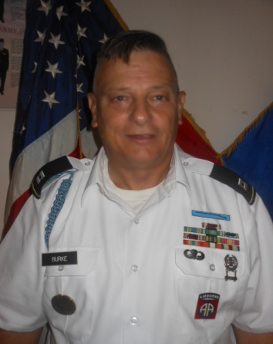
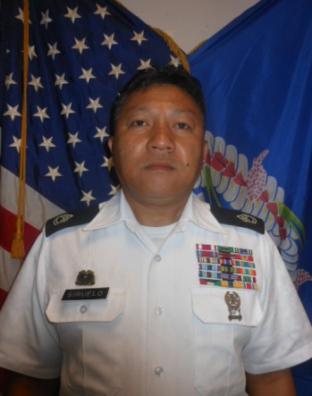
SAI & AI REMARKS
CPT. Burke, James
Senior Army Instructor
SFC Giovanni Siruelo
Army Instructor
Hello from the JROTC here at Kagman. The year is going fast and furious into the FUTURE. We want you to enjoy the upcoming holidays here at Kagman High. Be good and safe on Halloween night. Have fun and good luck on the door decorating contest. Study hard & get good grades so you can go to college for a great life. BOOOOYAA!
Captain James Burke
Stay safe and have a great Halloween!
HOOOAH!!

Slide 3
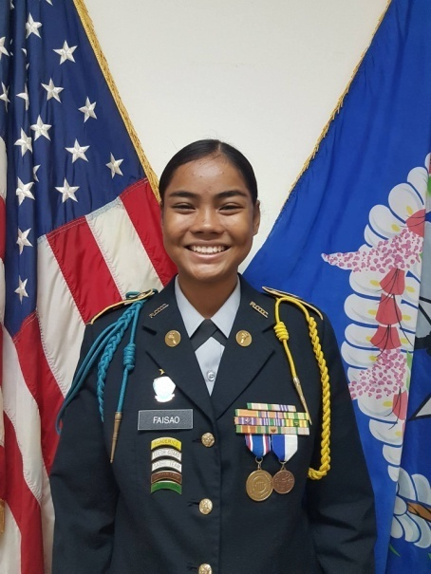
Battalion Commander Remarks
Good Afternoon everyone! I’m C/LTC Faisao, Kayleen, the Ayuyu Battalion Commander. Halloween falls on this week and I’m so excited to see what you all decide to dress as. I personally love this occasion because we can all become a different person for one night, and the possbilites are endless! I hope you all have fun and make good decisions. If something doesn’t feel right, don’t do it. It’s that simple. I hope you all have a great time. Stay safe and take care. OORAH!!!

Slide 4
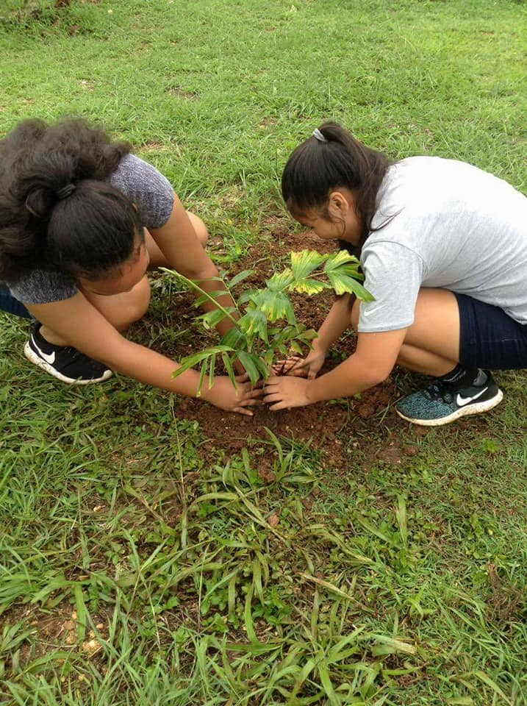
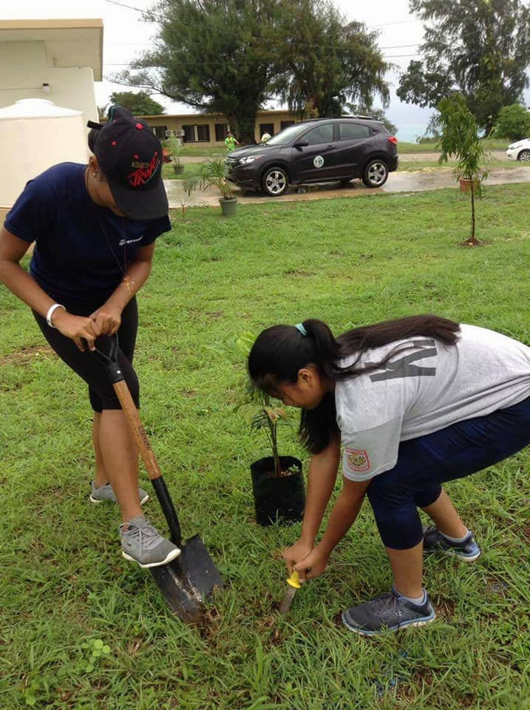
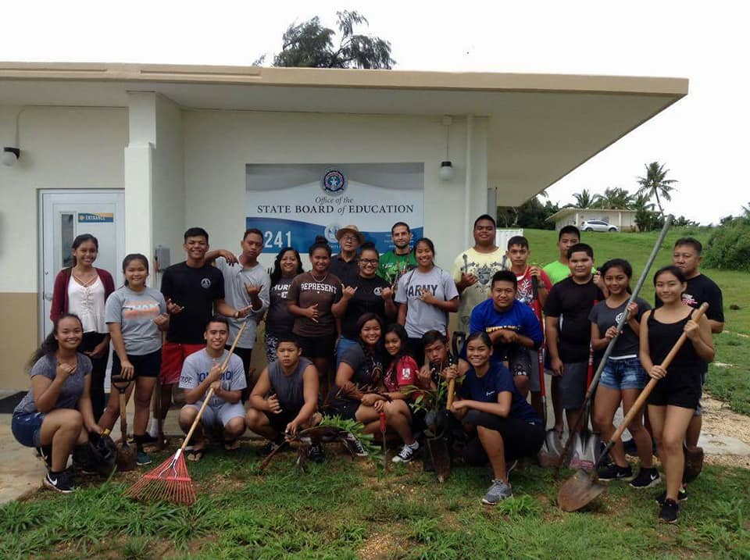
Beautification Project at State Board of Education 09.30.17
Takes two to plant.
Digging for Gold.
YAA! We made this place BEAUTIFUL!

Slide 5
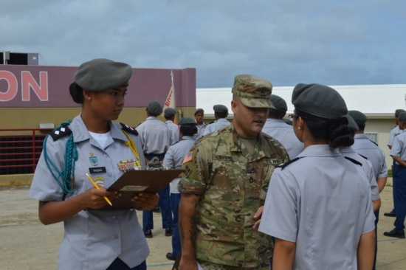
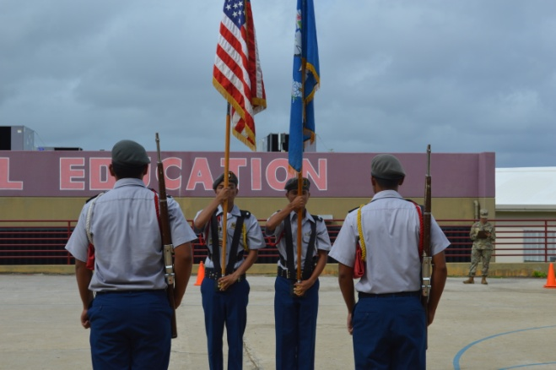
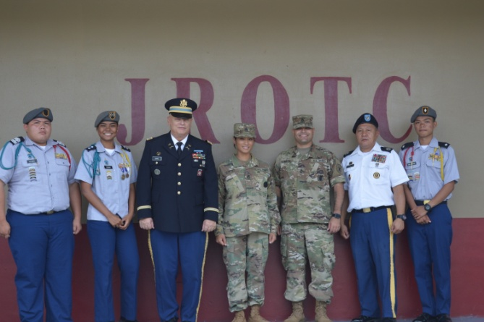
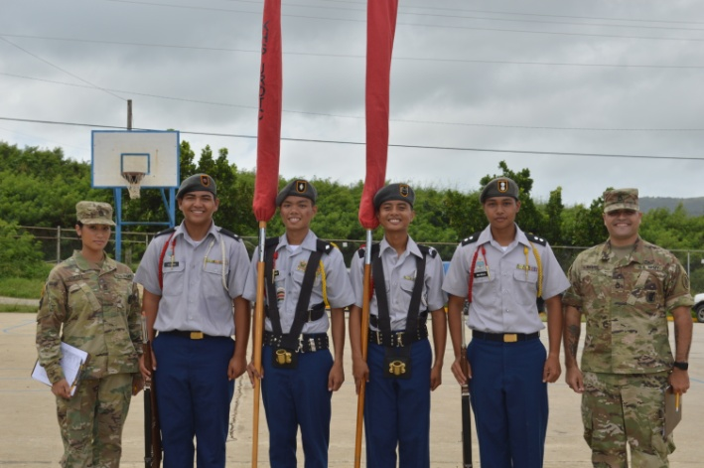
JPA Inspection
& Color Guard 10.25.17
What is the formula for relatively?
Ready, aim & SALUTE!
OK. We have the Bus Driver now
YAA! We got ya one point!

Slide 6
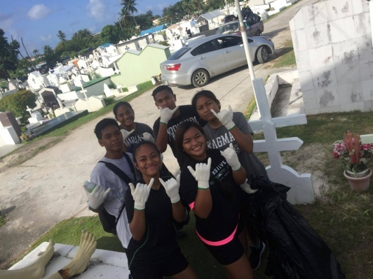
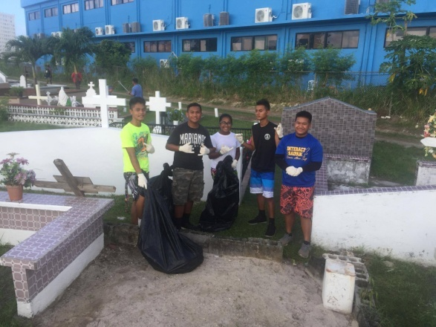
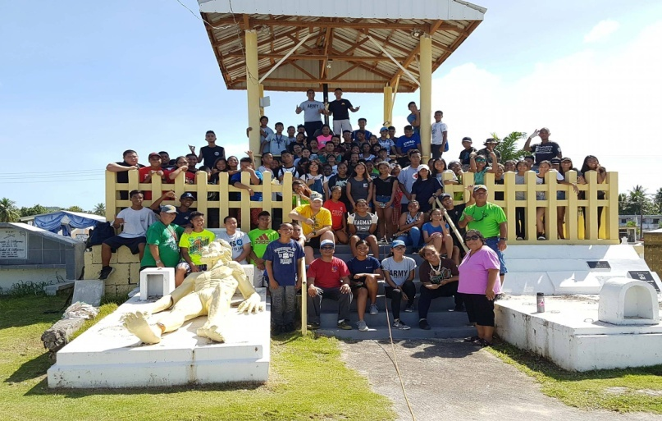
Cemetery Clean up at Mount Carmel 10.28.17
God Bless us for helping.
SHHH! Be quite & be respectful.
The whole clean-up crew . WHEW!

Slide 7
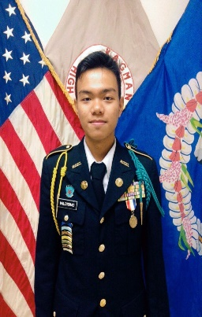
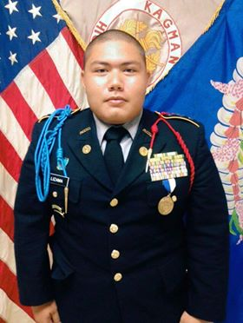
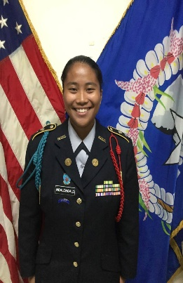
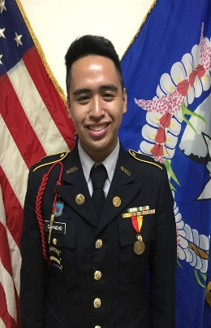
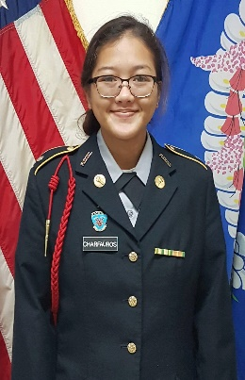
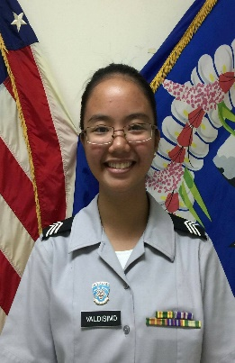
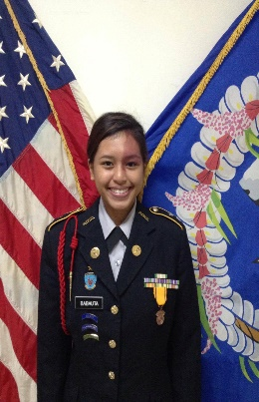
CHAIN OF COMMAND
BN CO
C/LTC Faisao, Kayleen
BN XO
C/MAJ Valdisimo, Edson
BN CSM
C/CSM Lizama, Jack
BN S-1 Adjutant Officer
C/1st LT Ngalongalo, Aira
BN S-2 Security & Intelligence Officer
C/1st LT Camacho, Bryan
BN S-3 Training Officer
C/2nd LT Charfauros, Mikeangela
BN S-4 Supply & Logistic Officer
C/2nd LT Valdisimo, Nina
BN S-5 Public Affairs Officer
C/CPT Babauta, Regiene

